Slide 1

Institution Networking System
Group Members:
Abd-Ur-Rehman (01-134222-002)
Muzammil Hussain(01-134222-115)

Slide 2
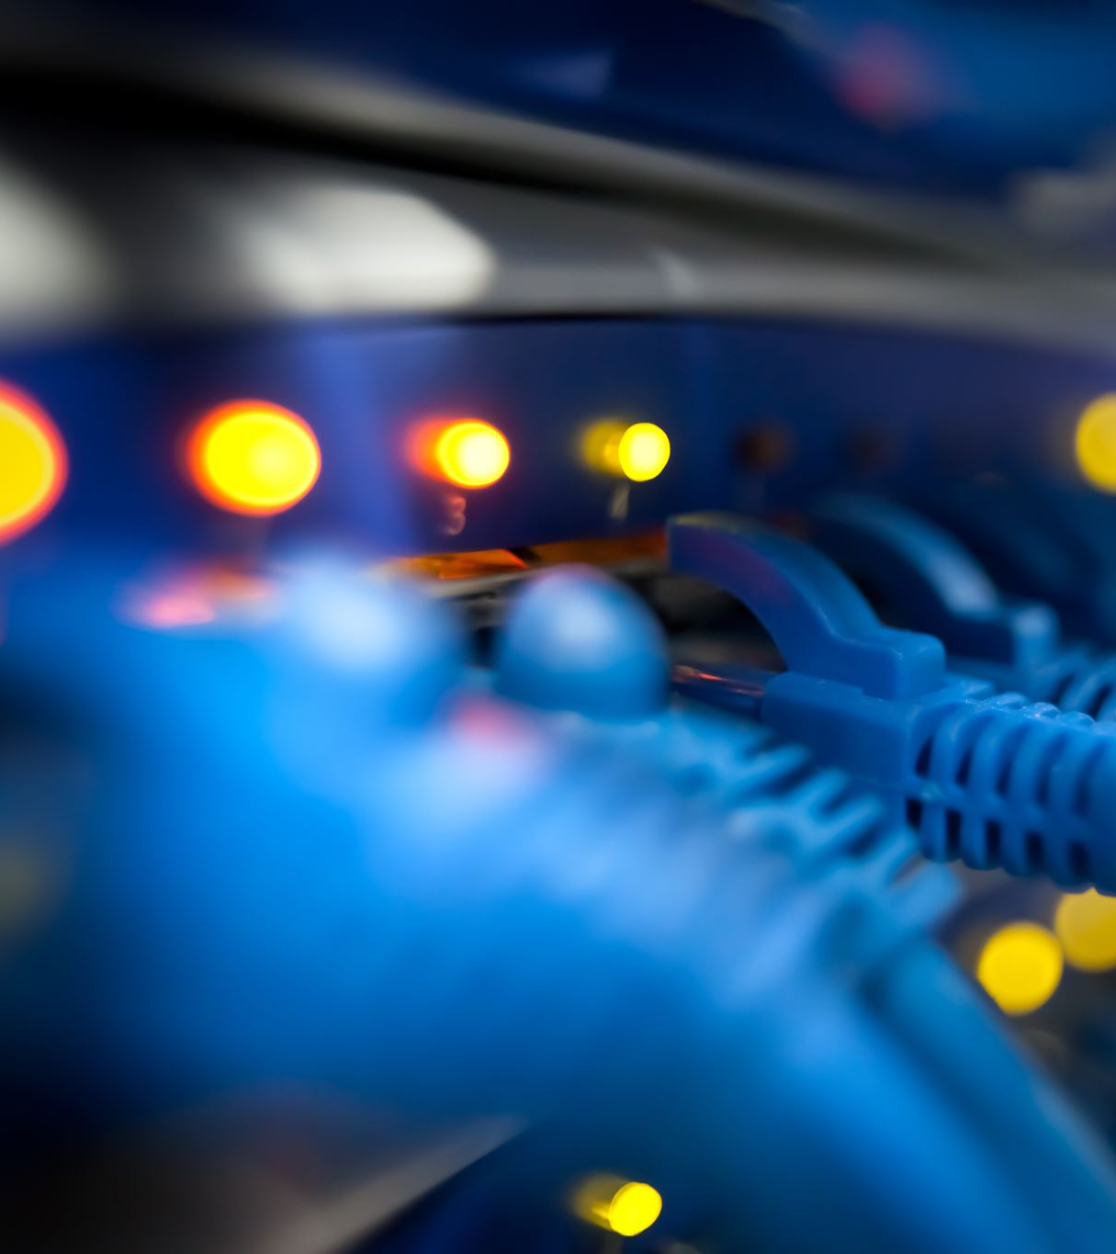
Networking Devices
Switches
Routers
PC’s
Server
Cables(crossover, serial DCE , straight through)

Slide 3

Implemented Concepts and Protocols
IP addressing
TFTP(Trivial File Transfer Protocol)
DCHP Configuration
VLAN
VTP
OSPF
RIP

Slide 4

OSPF(Open Shortest Path First)
OSPF is a dynamic link-state routing protocol used within an autonomous system. It uses the Dijkstra algorithm to compute the shortest path, supports hierarchical routing, and quickly adapts to network changes.

Slide 5
RIP (Routing Information Protocol)
RIP is a distance-vector routing protocol that uses hop count as the metric to determine the best path to a destination. It is simpler and less resource-intensive than OSPF but is limited by a maximum hop count of 15, making it less suitable for larger networks.

Slide 6
DHCP (Dynamic Host Configuration Protocol)
DHCP is a network management protocol used to automatically assign IP addresses and other network configuration parameters to devices on a network, enabling them to communicate effectively without manual intervention.

Slide 7
VLAN(Virtual Local Area Network)
VLAN is a technology that allows network administrators to segment a physical network into multiple logical networks. This enhances security and improves traffic management by isolating different groups of devices within the same physical network.

Slide 8
VTP(VLAN Trunking Protocol)
VTP is a Cisco proprietary protocol used to manage VLAN configuration across a network of switches. It simplifies the administration of VLANs by propagating VLAN definitions to all switches in a VTP domain, ensuring consistent VLAN configuration.

Slide 9
